Slide 1
Digraphs and Relations
2010 Zone B Question 7

Slide 2
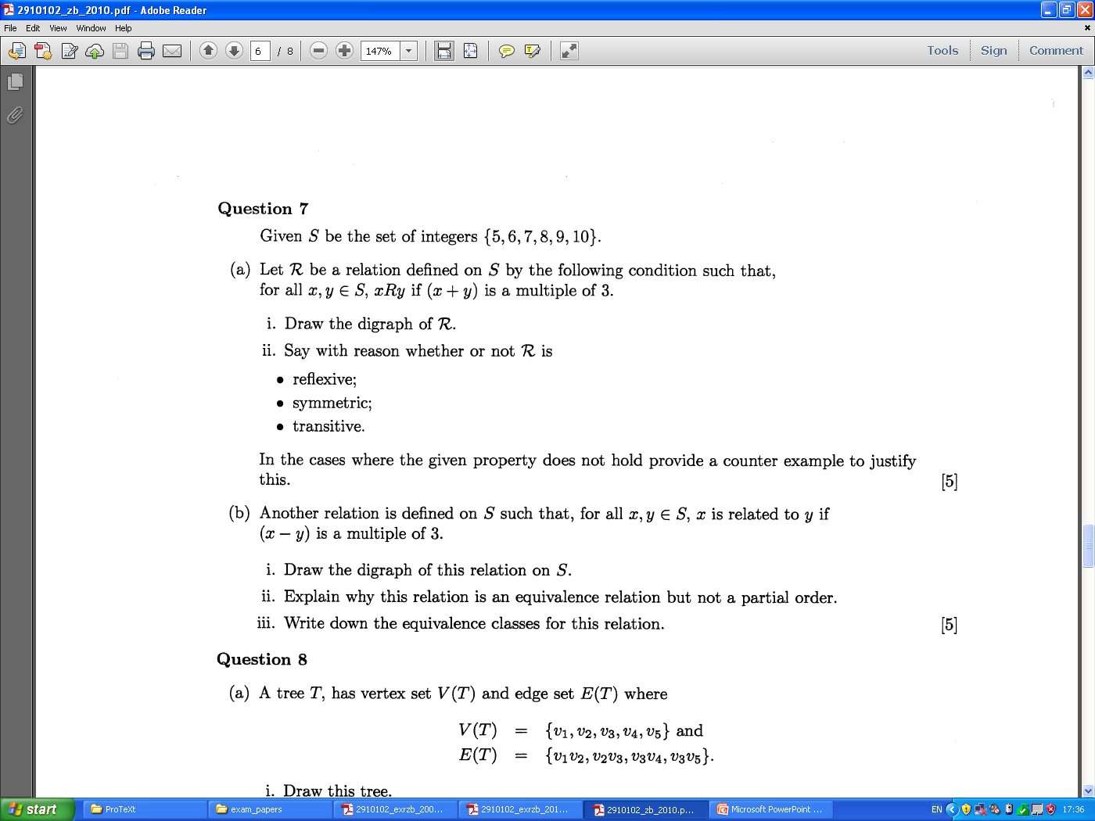
Digraphs and Relations

Slide 3
Digraphs and Relations

